Slide 1
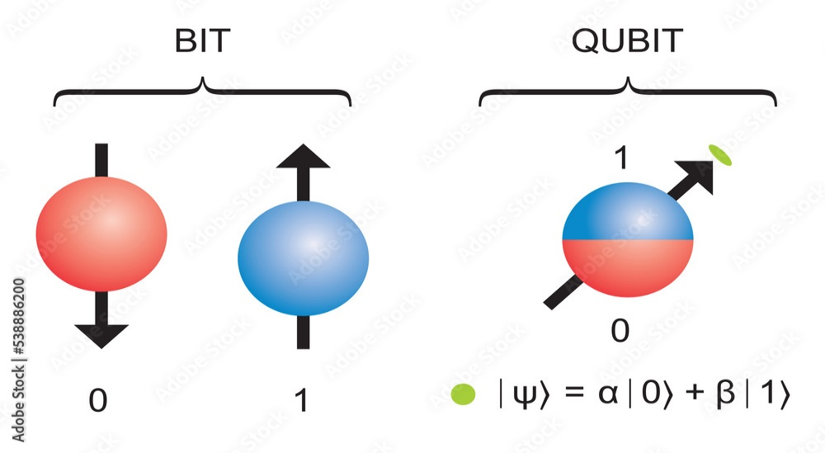
2. Qubit: Topics
1.Qubits and States
2.Representation of Qubits :
State Vectors
Dirac Notation : Basic Elements
Representing General Qubit States
Common Qubit states
Measurement in Qubit Notation
3. Inner Product and Outer Product
4. Perpendicular and Parallel Qubit Vectors
5. Magnitude and Normalization of the Qubit Vector
6. Angle between two Qubit vector using Dot Product
7. Linear Combination of two qubit vectors
8. Superposition of Qubits
9. Hilbert Space
10. Basis
11. Tensor Products
12. Entanglement of Qubits in Hilbert Space
13. Bell State
14. Complex numbers in Polar Form
15. Representing Qubits states in Bloch Sphere
A qubit, or quantum bit, is the fundamental unit of information in quantum computing, analogous to a classical bit in traditional computing.

Slide 2
N-qubit | Number of states | States | Examples
1 | 2^1 = 2 | |0⟩ and |1⟩ | A single qubit can be used as a highly sensitive quantum sensor to measure magnetic fields, electric fields, temperature, pressure and other quantities with extremely high precision
2 | 2^2 = 4 | 00⟩, |01⟩, |10⟩, and |11⟩ | Used to create entangled states, such as the Bell state 1/sqrt(2)*(∣00⟩+∣11⟩).
3 | 2^3 = 8 | |000⟩, |001⟩, |010⟩, |011⟩, |100⟩, |101⟩, |110⟩, and |111⟩ | A 3-qubit quantum computer can be used to simulate the behavior of a simple molecule like hydrogen (H2)
4 | 2^4 = 16 | |0000⟩, |0001⟩, |0010⟩, |0011⟩, |0100⟩, |0101⟩, |0110⟩, |0111⟩, |1000⟩, |1001⟩, |1010⟩, |1011⟩, |1100⟩, |1101⟩, |1110⟩, and |1111⟩. | A 4-qubit computer can be used to implement Grover's algorithm, which searches an unsorted database
8 | 2^8 = 256 |  | An 8-qubit quantum computer can be used to factor large numbers using Shor's algorithm,
30 | 2^30 = 1 billion |  | Could be used to simulate the behavior of complex molecules and materials, which is crucial for developing new drugs, batteries, and other technologies

Slide 3
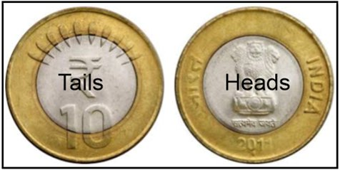
2.2 Representation of Qubits
State Vector : Each element in the state vector represents probability of being in that particular state.
State vector = [ H T]
If the coin is in the head’s state , state vector = [1 0]
If the coin is in the tail’s state , state vector = [0 1]
State vector is used to represent the state of quantum systems

Slide 4
Dirac Notation
Dirac notation, also known as bra-ket notation, is a standard way to represent quantum states and operations in quantum mechanics. It is particularly useful in describing qubits and quantum systems.
Ket ∣ψ⟩ : Column Vector
Bra ⟨ψ∣ : Row Vector
Bra-Ket : ⟨ψ∣ ψ⟩ Inner Product
Ket- Bra: ∣ψ⟩ ⟨ψ∣ Outer Product

Slide 5

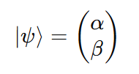
Basic Elements of Dirac Notation
Ket |ψ⟩:
Represents a column vector (a quantum state).
Bra ⟨ψ|: Represents the conjugate transpose (row vector) of the ket.
where α∗ and β∗ are the complex conjugates of α and β.

Slide 6
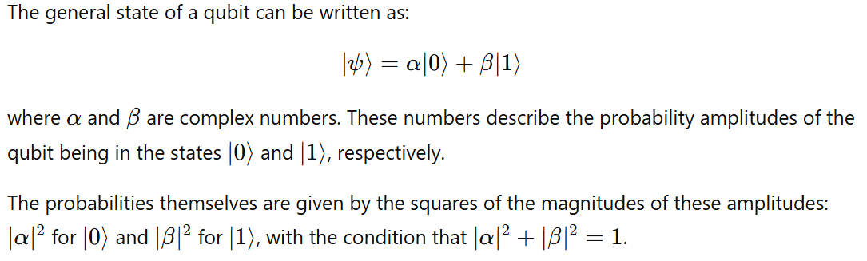
Qubit States

Slide 7
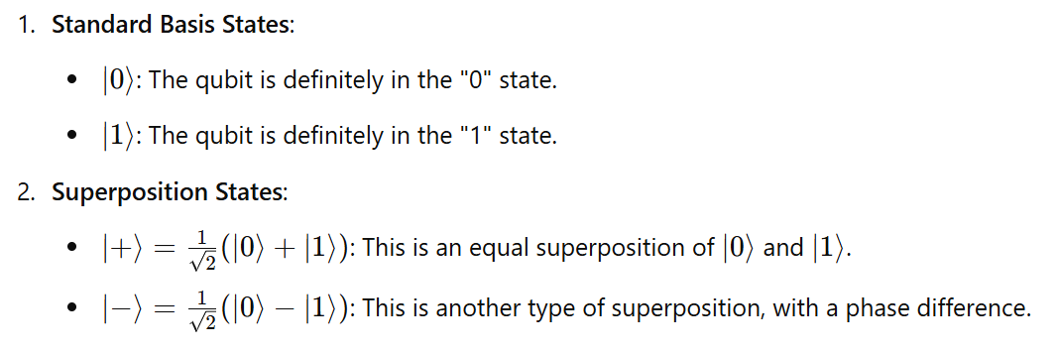
Common Qubit States

Slide 8

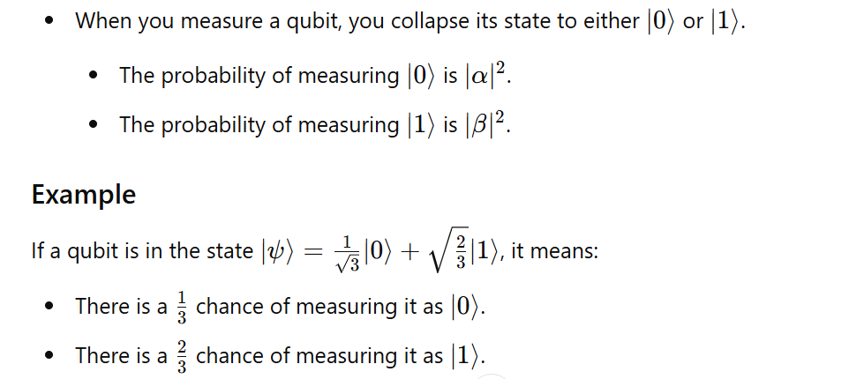
Measurement in Qubit Notation

Slide 9
2.3 Inner Product and Outer Product

Slide 10
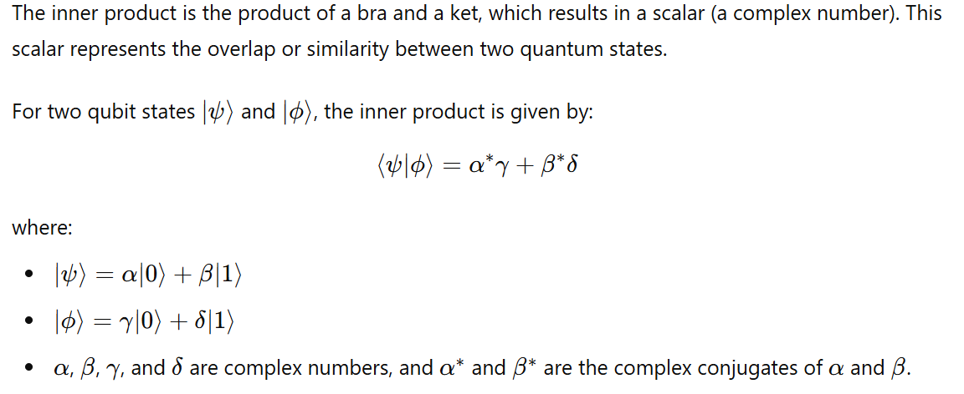
Bra-Ket: Inner Product (⟨ψ|ϕ⟩)

Slide 11
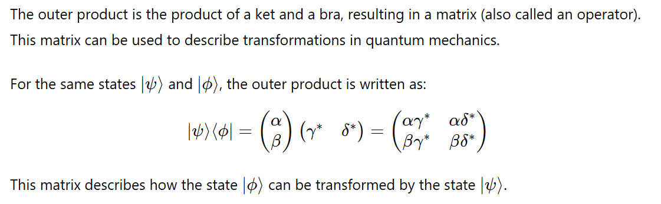
Ket-Bra: Outer Product (|ψ⟩⟨ϕ|)

Slide 12
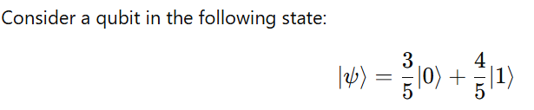




Inner Product Example

Slide 13
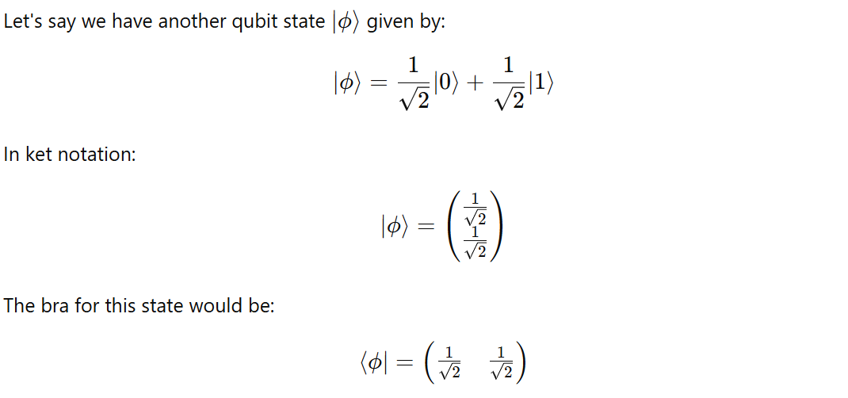
Inner Product Example

Slide 14
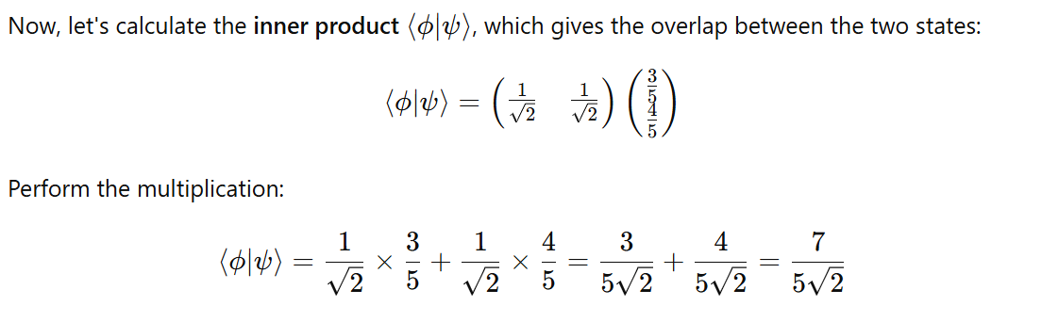
Inner Product Example

Slide 15
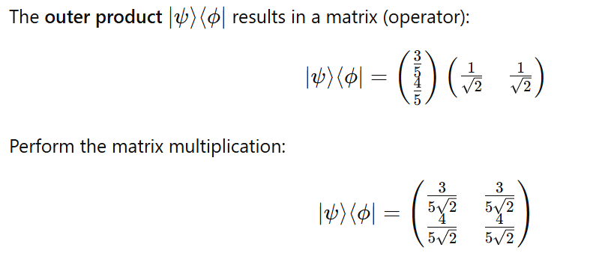
Outer Product Example

Slide 16
2.4 Perpendicular and Parallel Qubit Vectors

Slide 17
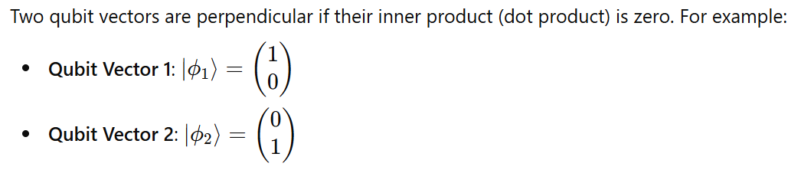

Perpendicular Qubit Vectors

Slide 18
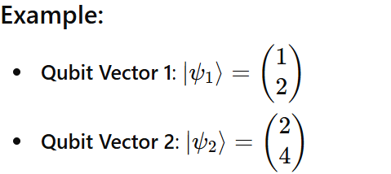
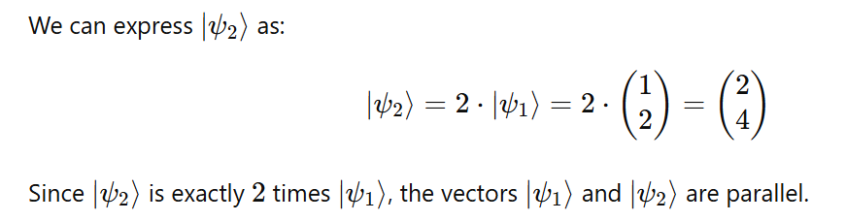
Two Parallel Qubit Vectors

Slide 19
2.5 Magnitude and Normalization of the Qubit Vector

Slide 20
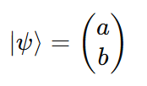
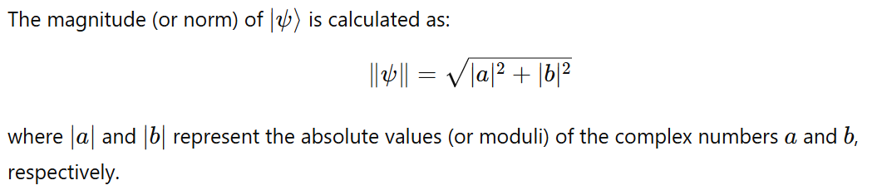
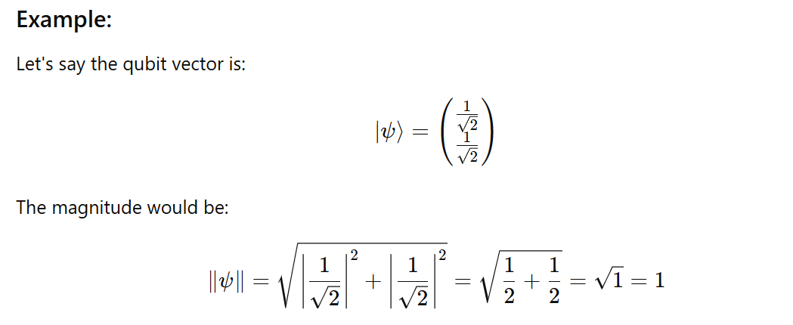
Magnitude of the Qubit Vector

Slide 21
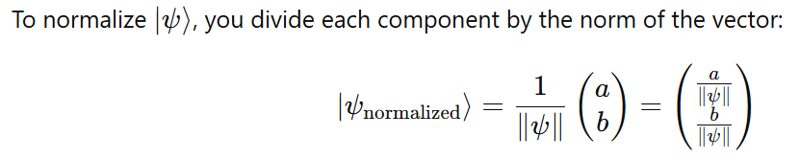
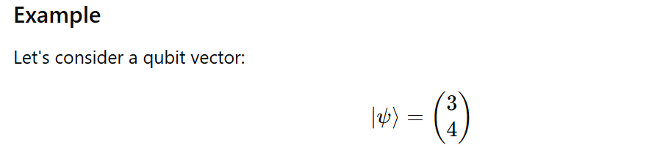
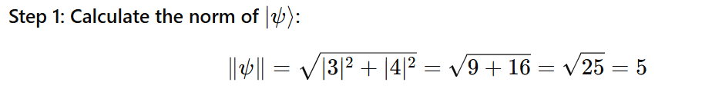
Normalization Process

Slide 22
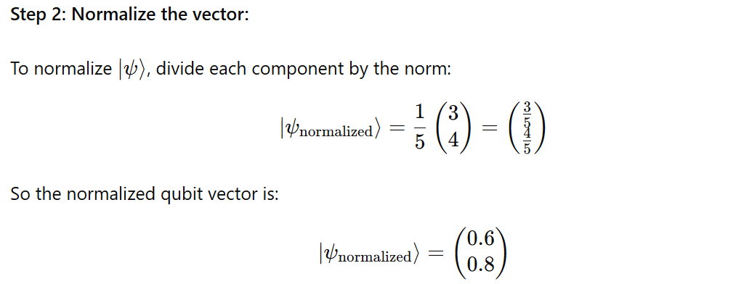
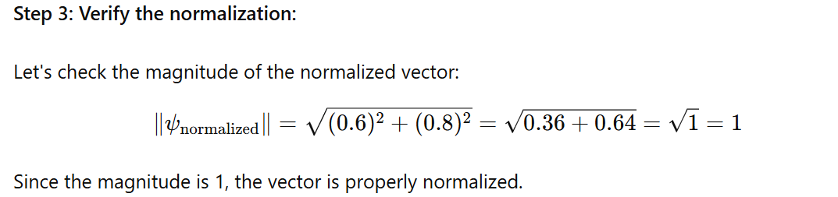
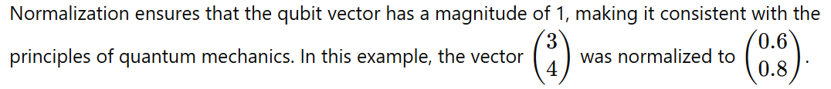

Slide 23
2.6 Angle between two Qubit vector using Dot Product

Slide 24
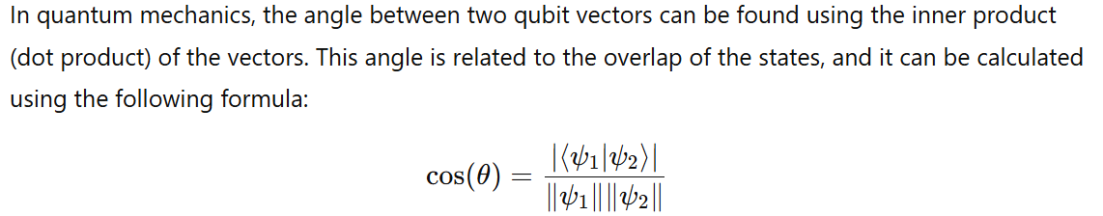
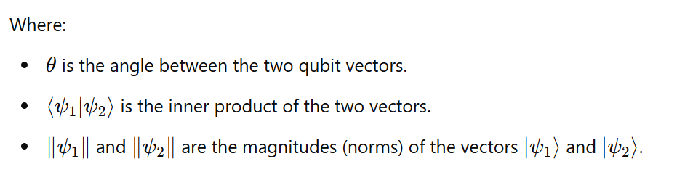
Finding the Angle Between Two Qubit Vectors Using the Dot Product

Slide 25
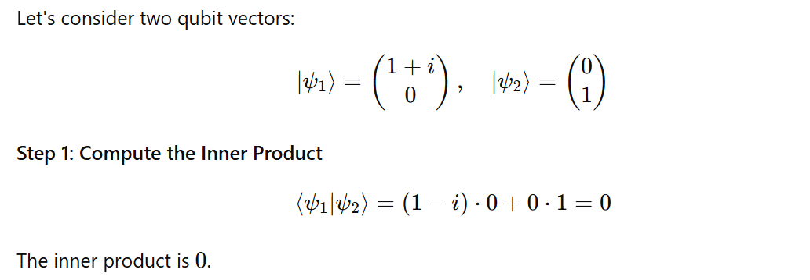
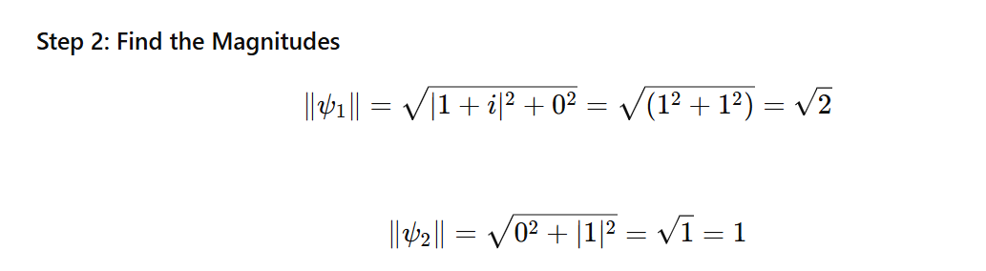
Example

Slide 26
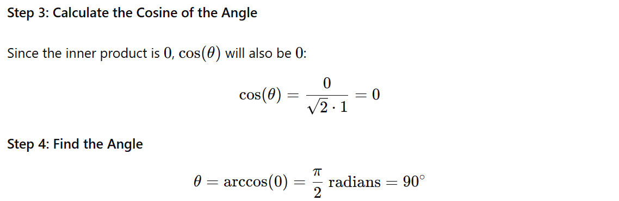
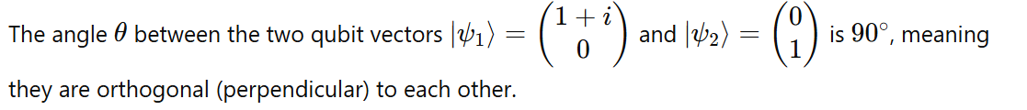

Slide 27
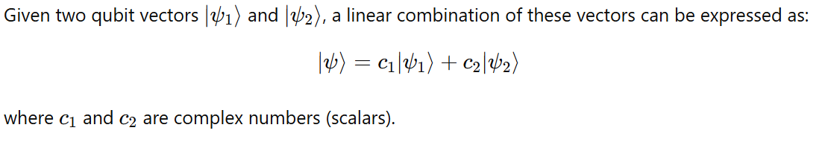
2.7 Linear Combination of Two Qubit Vectors
A linear combination of two qubit vectors involves creating a new qubit vector by adding the vectors together, each multiplied by a scalar (which can be a complex number).

Slide 28
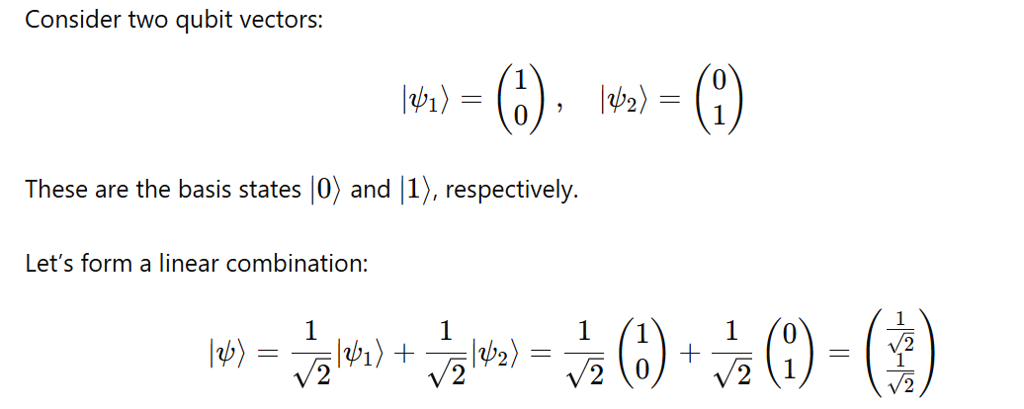
Example

Slide 29
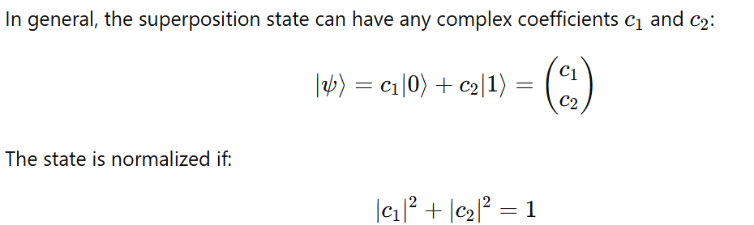
2.7 Superposition of Qubits

Slide 30
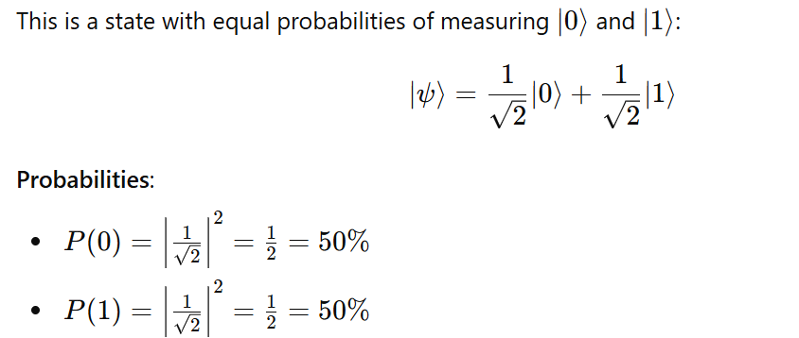
1. Equal Superposition

Slide 31
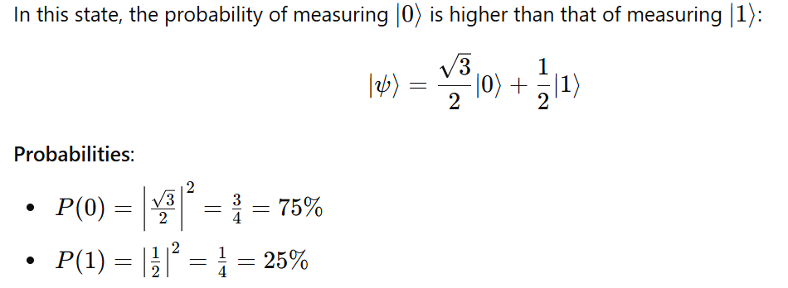
2. Biased Towards ∣0⟩

Slide 32
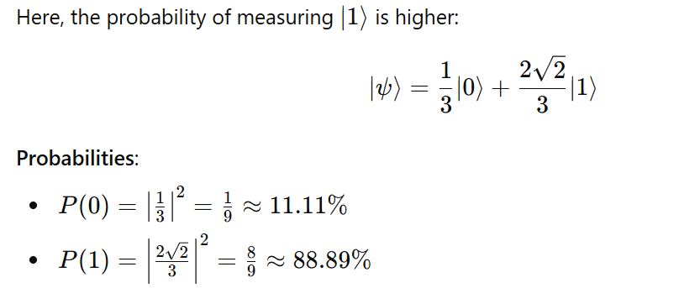
3. Biased Towards ∣1⟩

Slide 33
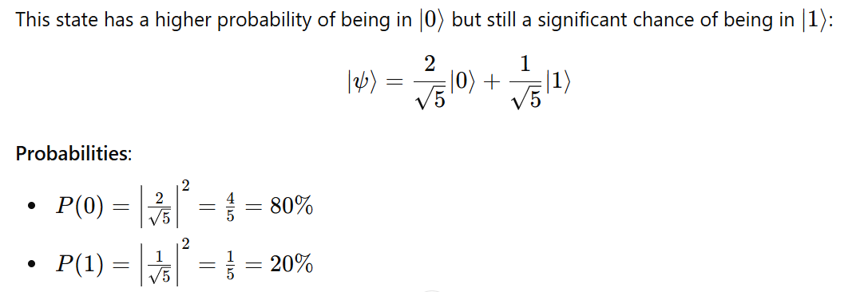
4. Closer to ∣0⟩

Slide 34
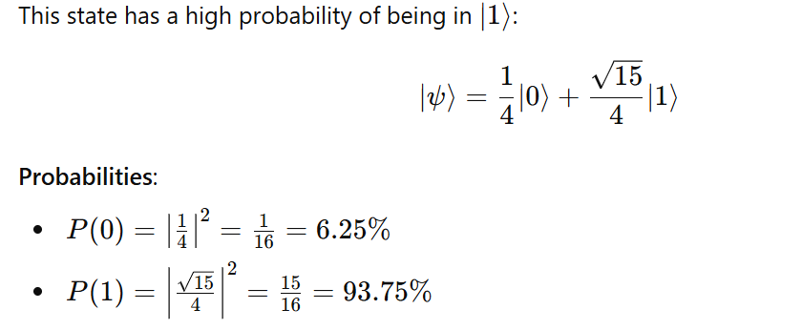
5. Very Close to ∣1⟩

Slide 35
Note
Ket notation ∣𝜓⟩: Represents the state as a column vector.
Bra notation ⟨𝜓∣: Represents the conjugate transpose of the ket as a row vector.
Inner product ⟨𝜙∣𝜓⟩: Gives a scalar, indicating the overlap between two quantum states.
Outer product ∣𝜓⟩⟨𝜙∣: Results in a matrix, useful for constructing quantum operators.

Slide 36
2.9 Hilbert Space in Quantum Computing
A Hilbert space in quantum computing is a mathematical framework used to describe the state space of quantum systems. It is a complete inner product space where:
Vectors represent quantum states.
Inner product defines the overlap or similarity between states.
Norm of a vector represents the probability amplitude of finding the system in that state.
Unitary Operators represent quantum gates.
Projection Operators represent measurements.
Probabilities are calculated based on the norms and inner products.

Slide 37
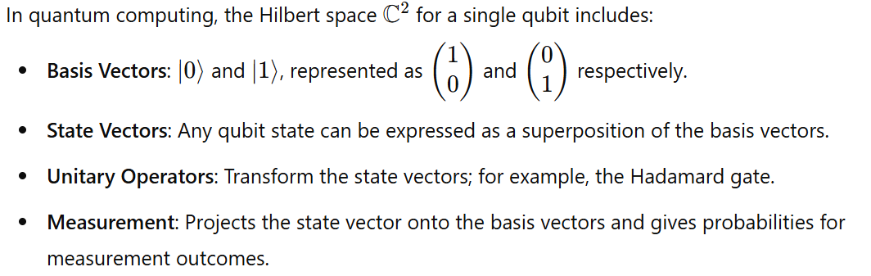
Hilbert Space in Quantum Computing

Slide 38
2.10 Basis in Quantum Mechanics
In quantum mechanics, a basis typically refers to a set of orthonormal vectors in a Hilbert space.
For qubits, the basis vectors are often represented as ∣0⟩ and ∣1⟩, which are the standard basis vectors for a single qubit

Slide 39
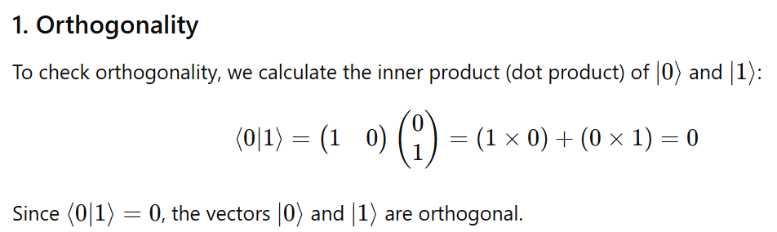
|0> and |1> are ortho normal basis

Slide 40
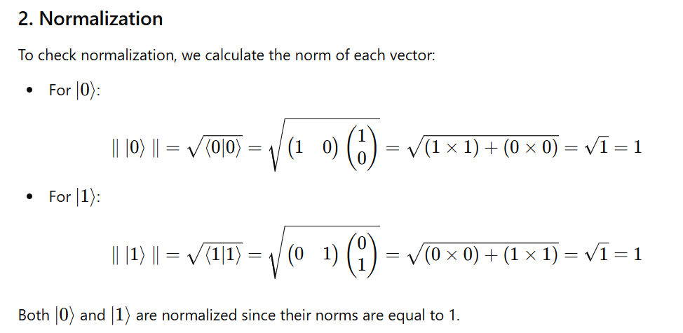
|0> and |1> are ortho normal basis

Slide 41
2.11 Tensor Products
If we have two vector spaces V and W, their tensor product of V and W is a new vector space formed from all possible combinations of vectors from V and W.
The dimension of the tensor product space is the product of the dimensions of the individual spaces.
For example, if V has dimension m and W has dimension n, then tensor product of V and W has dimension m×n.

Slide 42
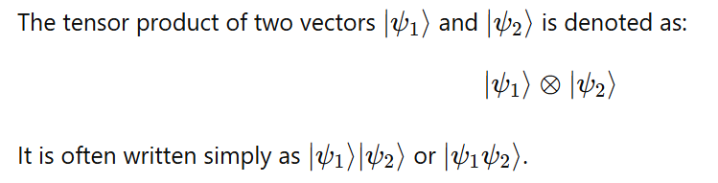
Tensor Product Notation

Slide 43
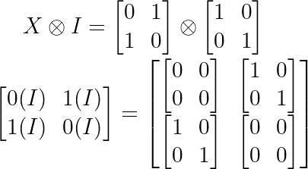
Example 1 :

Slide 44
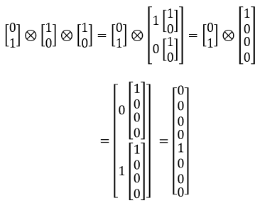
Example 2:

Slide 45
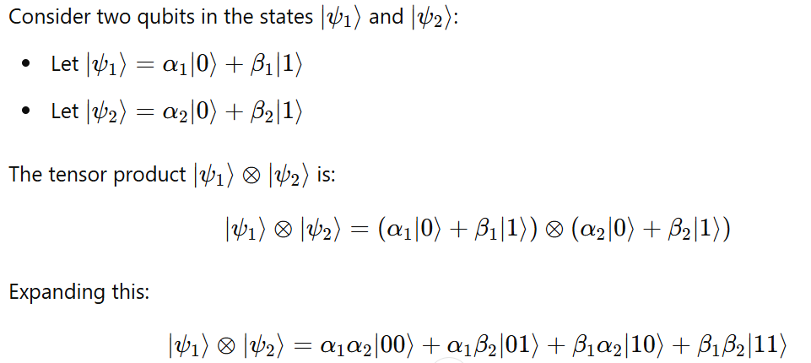
Example 3:

Slide 46
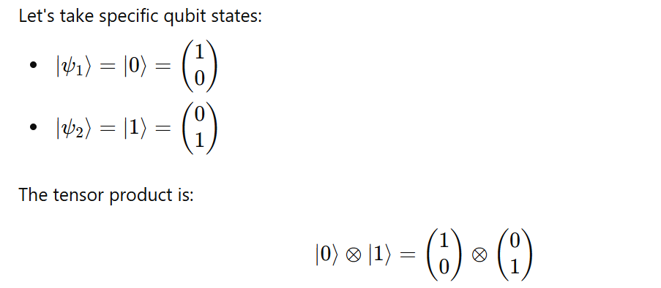
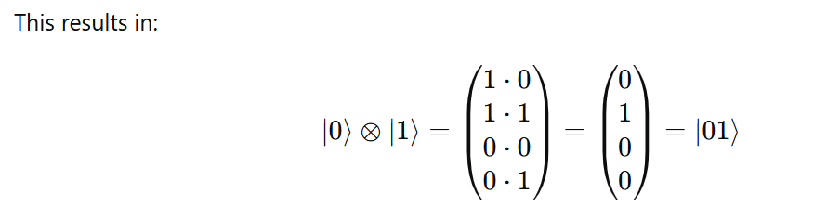
Example 4:

Slide 47
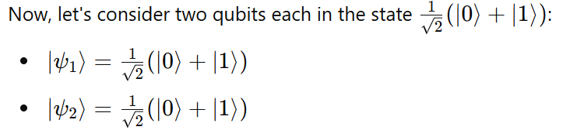
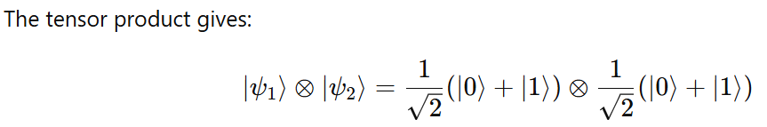


Example 5:

Slide 48
2.12 Entanglement of Qubits in Hilbert Space
Entanglement is a quantum phenomenon where two or more qubits become linked in such a way that the state of one qubit is dependent on the state of the other, no matter the distance between them.
This relationship persists even if the qubits are separated by large distances, leading to correlations in their measurements.
In quantum computing, entangled states are described using the Hilbert space of multiple qubits.
Entanglement involves quantum states that cannot be factored into separate states of individual qubits:

Slide 49

Entanglement of Qubits in Hilbert Space
Entanglement is a quantum phenomenon where two or more qubits become linked in such a way that the state of one qubit is dependent on the state of the other, no matter the distance between them.
Entanglement involves quantum states that cannot be factored into separate states of individual qubits.
Example :

Slide 50
2.13 What is Bell State?
The Bell states are specific quantum states of two qubits that are maximally entangled.
They are named after physicist John Bell, who studied the implications of entanglement for quantum mechanics and classical physics.
There are four Bell states, each representing a different kind of entanglement between the two qubits.

Slide 51
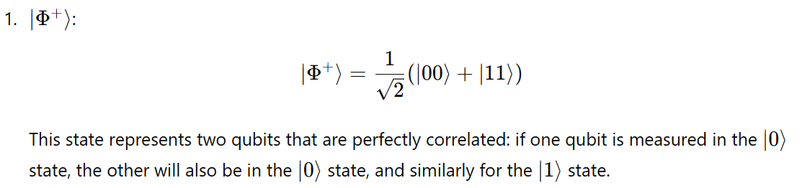

Slide 52


Slide 53


Slide 54


Slide 55


Prove that The Bell State is entangled state

Slide 56





Slide 57



Slide 58



Slide 59


2.14 Complex Numbers in Polar Form

Slide 60


2.15 Representing QuBits states using Bloch Sphere
The state of a qubit can be represented as a point on the Bloch Sphere
It is a unit sphere, where r=1.

Slide 61



Slide 62




Slide 63
Representing QuBits states using Bloch Sphere
A Bloch sphere uses its three axes to represent a qubit’s state. The state vector originates in the center of the sphere and terminates at a point with z, x, and y coordinates.
The z-axis represents the probability of the qubit being measured as a 0 or a 1.
The x-axis represents the real part of the state vector.
The y-axis represents the imaginary part of the state vector.

Slide 64

Qubit State in Polar Coordinates

Slide 65




Slide 66









Slide 67







